Slide 1

Intro to NServiceBus
7 – Full Duplex

Slide 2
Full Duplex Communication
Models the standard RPC mechanism
It is really two correlated one-way async messages
Request does not block waiting for reply
But, the response is sent back to only the caller
NServiceBus embeds message correlations IDs in the message headers to relate the return message to where it should go
Messages are design in pairs – the request and the response
A server that receives the request object Bus.Reply’s the response message
A Client IHandleMessages<ResponseMessage> and will receive them

Slide 3
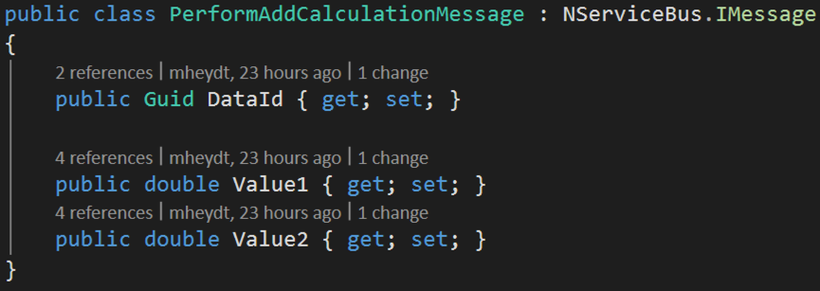
Example messages for an Add service: Request

Slide 4
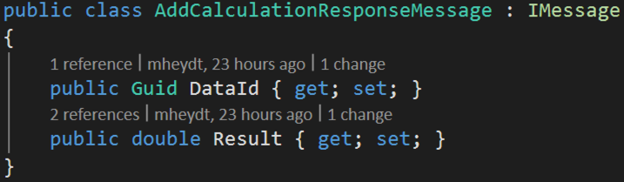
Response message

Slide 5
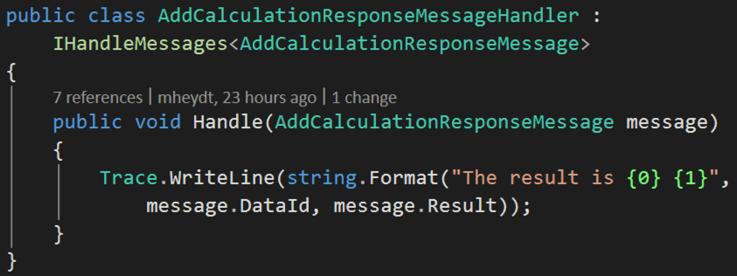
Client handles the response message

Slide 6
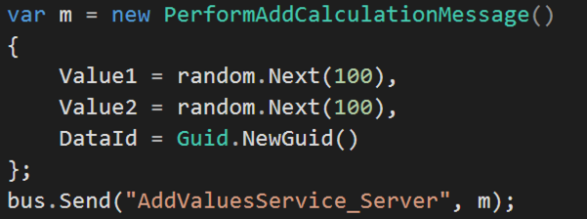
Client sends a message

Slide 7
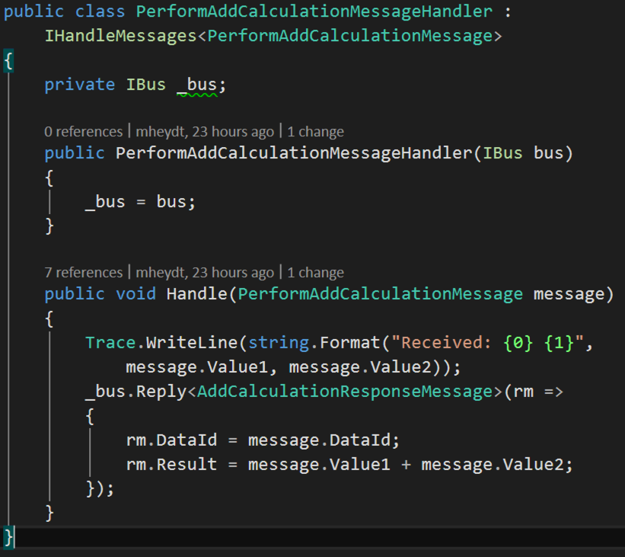
Message is received and replies

Slide 8
Client’s handler receives the reply
Note that the receipt is async from the request
Although NServiceBus correlates the request / reply messages along the bus, you still need to do this manually with your messages if you want need it
Hence, in this example there is a Guid Id in the message that could be used to relate the result of the addition to the request.

Slide 9
Demo: Full Duplex

